Slide 1

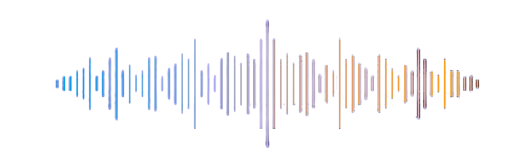

Personal Voice Assistant
Presented by:-
G.YASWANTH -19MC1A0534
SK.P.SHAHID -19MC1A05399
O.TEJA NARASIMHA RAO -19MC1A0579
L.RUSHENDAR REDDY -19MC1A0557
Guided by:
B.DHARAMA RAJU

Slide 2
CONTENT:-
Introduction
Abstract
EXISTING SYSTEM
PROPOSEDSYSTEM
MODULES
REQUIREMENTS:-
1.software
2.hardware
3.functional
4.non-functional
Designs
1.uml diagrams
2.database designs
3.algorithms
Execution screenshot
Future scope
Conclusion

Slide 3
INTRODUCTION :-
Nowadays the Mobile Technology is being very famous for the User Experience, because it is very easy to access the applications and services from anywhere of your Geolocation. Android, Apple, Windows, Blackberry, etc. are various famous and commonly used Mobile Operating Systems. All the Operating Systems provides plenty of applications and services for users. For an instance, the Contacts Applications is used to store the contact details of the user's contact and also helps user to connect a call or send an SMS to other person using the contents stored in this application. We can get similar types of application all around the world via Apple Store, Play Store, etc. All this features gives birth to various kinds of sensors or functionalities to be implemented in the mobile devices. The Most famous application of iPhone is “SIRI” which helps the end user to communicate end user to mobile with voice and it also responds to the voice commands of the user. Same kind of application is also developed by the Google that is “Google Voice Search” which is used for in Android Phones. But this Application mostly works with Internet Connections. But our Proposed System has capability to work with and without Internet Connectivity. It’s named as Personal Assistant with Voice Recognition Intelligence, which takes the user input in form of voice or text and process it and returns the output in various forms like action to be performed or the search result is dictated to the end user.

Slide 4
Abstract:-
Voice control is a major growing feature that change the way people can live.
The voice assistant is commonly being used in smart phones and laptops.
AI-based Voice assistants are the operating systems that can recognize human voice and respond via integrated voices.
This voice assistant will gather the audio from the microphone and then convert that into text, later it is sent through GTTS (Google text to speech).
GTTS engine will convert text into audio file in English language, then that audio is played using play sound package of python programming Language

Slide 5
Exciting system
In existing system user use to search by using keyboard typing.it takes lot of times to search.
In recent times only in the Voice Assistants we can experience the major changes, the way user interacts and the experience of user.
We are already using them for many tasks like switching on/off lights, playing music through streaming apps like Wynk Music, Spotify etc., This is the new method of interacting with the technical devices makes lexical communication as a new ally to this technology.
It's dis-advantages
They Make Common Grammatical Errors
They Incur High Costs
They Make Communication Less Personal
Lack of Accountability

Slide 6
Proposed system:-
The project will give a fair knowledge about the intelligent assistant which is capable of understanding the commands given by the user.
Our assistant can easily understand the commands given by the user through vocal media and responds as required.
Our assistant performs the most frequently asked requests from the user and makes their task easier.
Our voice assistant listens to the command given by the user through the microphone. After listening it will says ‘speaking’and displays what the user said and acts accordingly.
It's advantages :-
They Can Speak Multiple Languages
They are Easy to Use with GPS Tracker Software
They Provide Instant Access to Information
We can Use Them Anywhere, Anytime

Slide 7
MODULES:
Office Mathematical Operations
Online Operations
Exit
MODULES DESCRIPTION:
1.Office Mathematical Operations
In this module user will speak about Mathematical Operations.In this module all Mathematical Operations is carried out.
(Eg:1+2=3)
2.Online Operations
In this module user will speak about search related task. It will search in online using google search.
Eg:Temperature
3.Exit

Slide 8
Hardware & Software requirement:-
HARDWARE REQUIREMENTS:
System : Pentium Dual Core.
Hard Disk : 120 GB.
Monitor : 15’’ LED
Input Devices : Keyboard, Mouse
Ram : 1 GB
SOFTWARE REQUIREMENTS:
Operating system : Windows 10
Coding Language : python
Tool : PyCharm
Database : MYSQL
Server : Flask

Slide 9
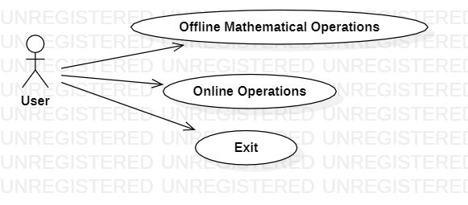
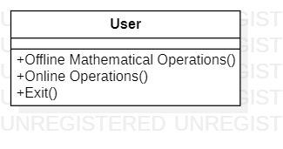
Design:-
Uml diagram
USE CASE DIAGRAM
User
Check
Unauthorized user
Yes NO
Offline Mathmatice operations
Online operations
CLASS DIAGRAM
EXIT
End process

Slide 10
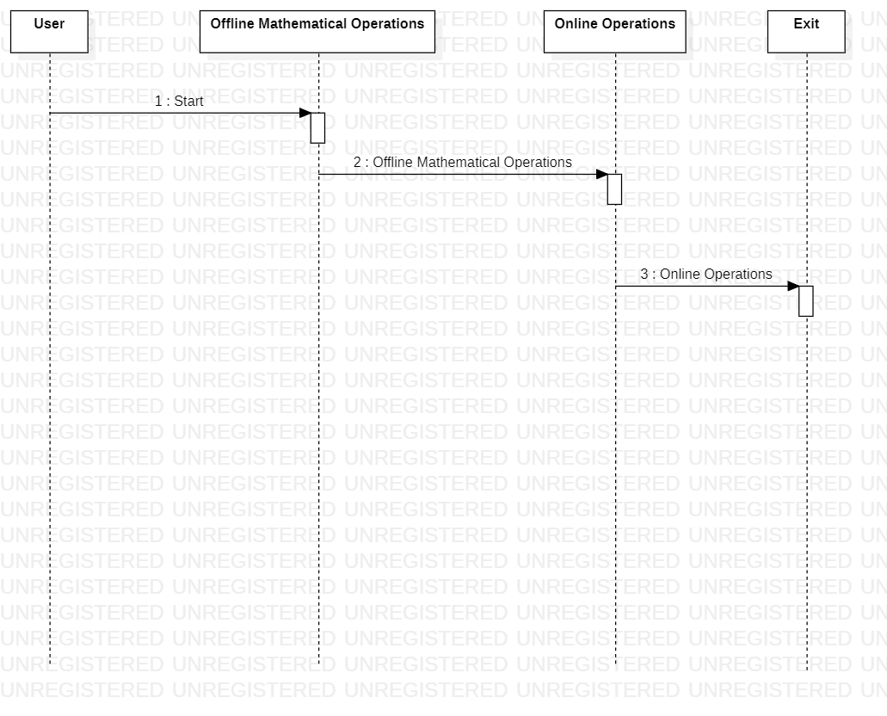
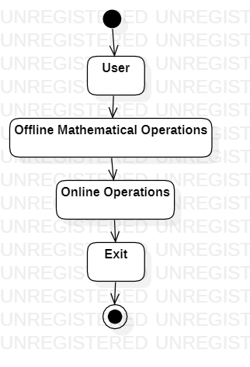
SEQUENCE DIAGRAM
ACTIVITY DIAGRAM

Slide 11
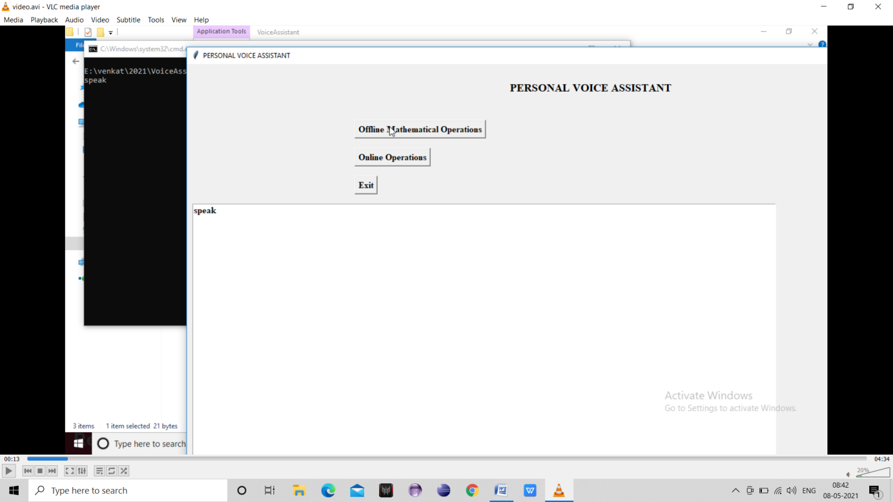
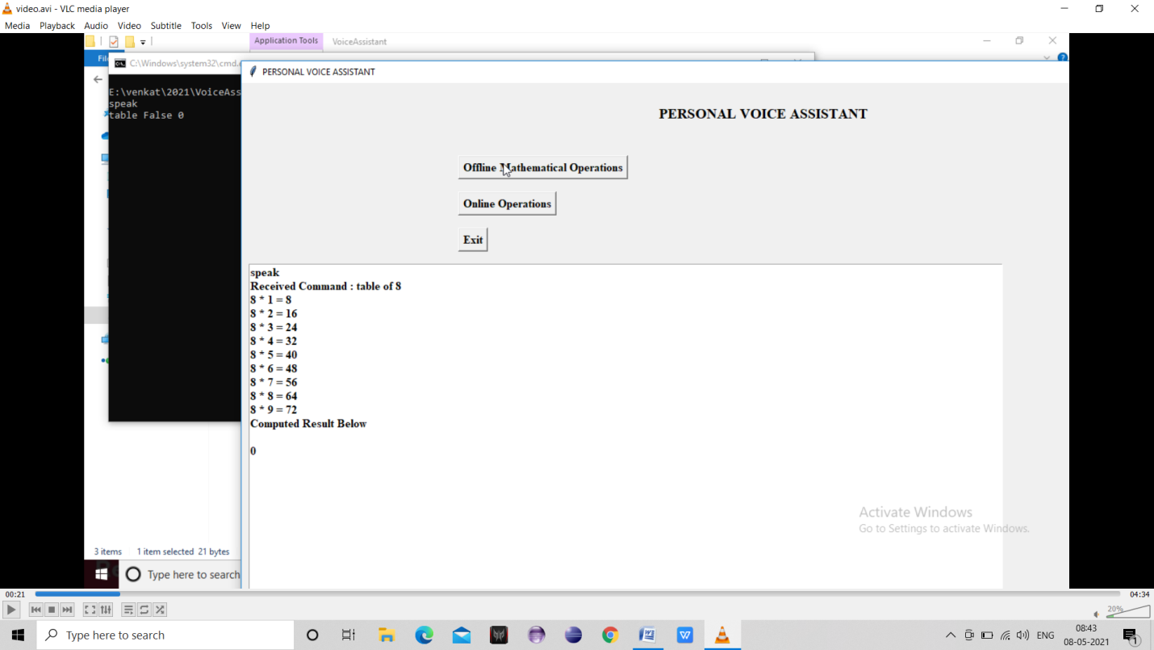
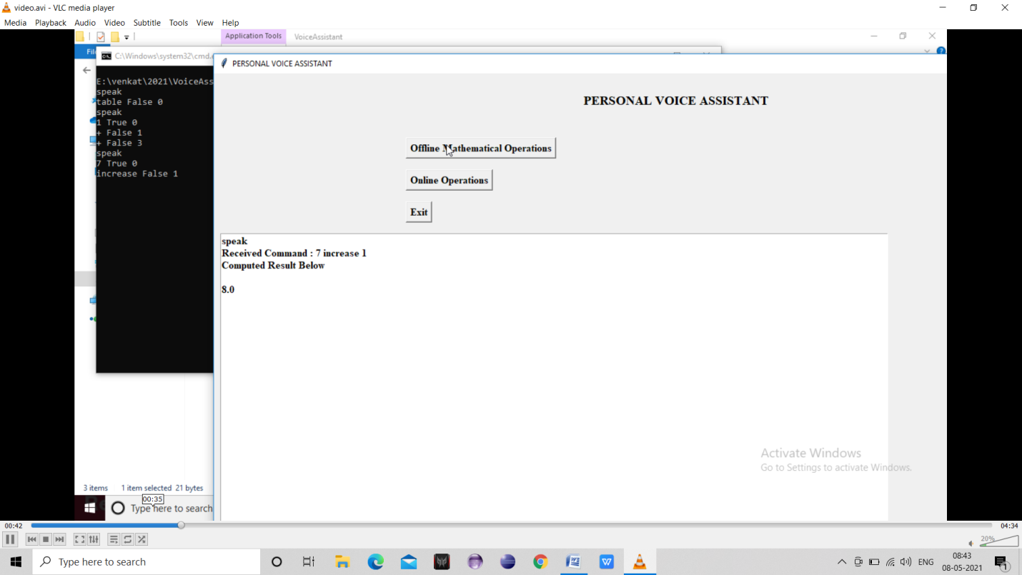

Slide 12
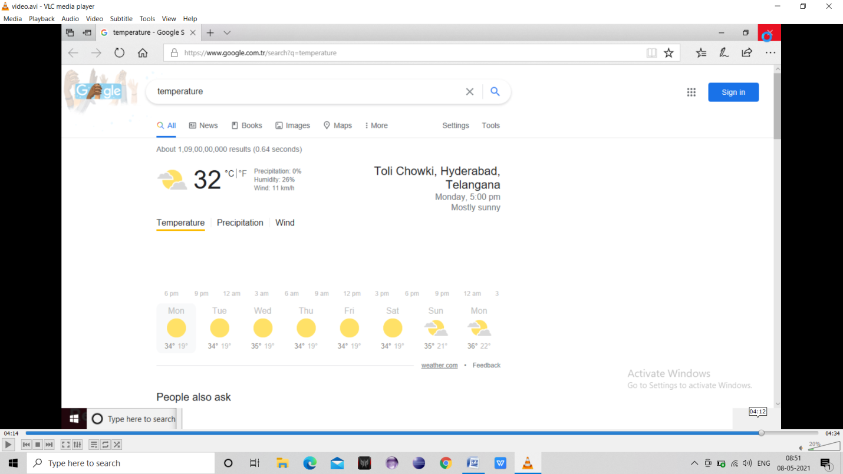
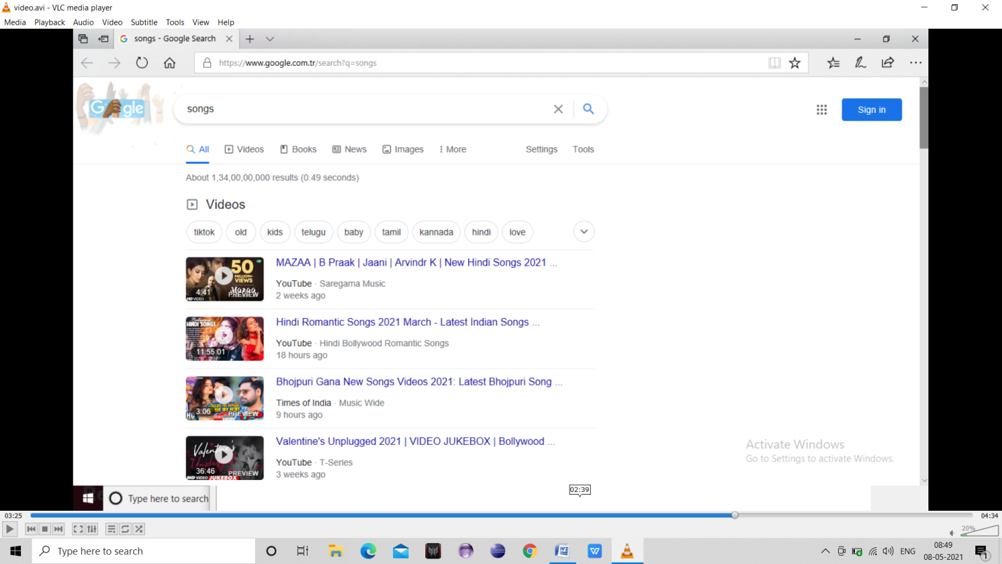

Slide 13
FUTURE ENHANCEMENT
In future voice assistants can be used for two developments: First quality of dialogue recognition will increase because broadband allows more complex data processing in powerful data centres. Second, from the users perspective, VAs aid for interaction. In the companies, voice assistants can be used to automate repetitive tasks for book meeting rooms and restaurants etc
CONCLUSION
In our project we have implemented many things compared to other assistants. Now a days it is very useful in human life because it is a hands-free application. It is a very simple application. As well as it is used in a business field also for example in laboratory, the person wears gloves and body suits for their safety purpose so it is difficult to type, through voice assistant they can get any information so that their work becomes easy. Voice assistants are useful in many fields such as education, daily life application, home appliances etc. and voice assistant is also useful for the illiterate people they can get any information just by saying to the assistant, luxury is available for people, thanks to AI based voice assistants.

